Slide 1
Lecture 14:
Videos
Unsupervised Learning

Slide 2
Administrative
Everyone should be done with Assignment 3 now
Milestone grades will go out soon

Slide 3
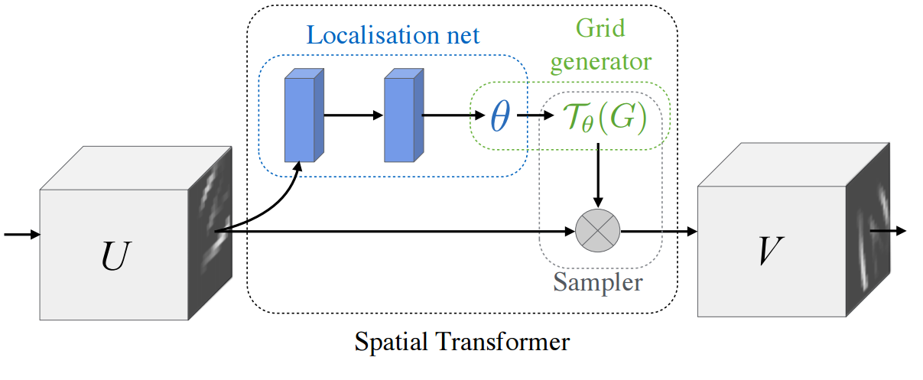
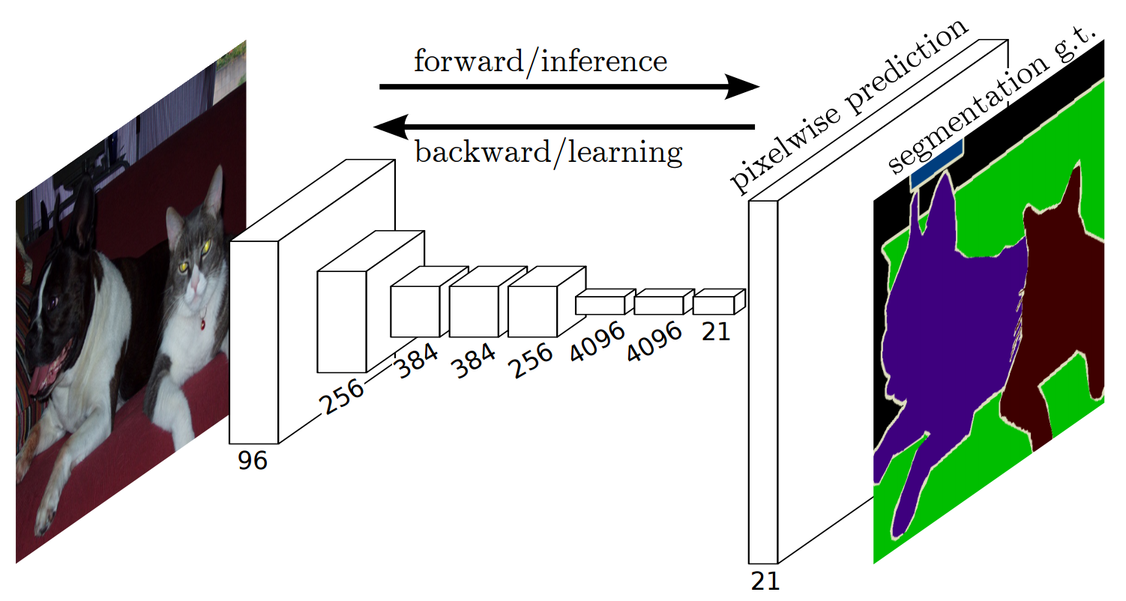
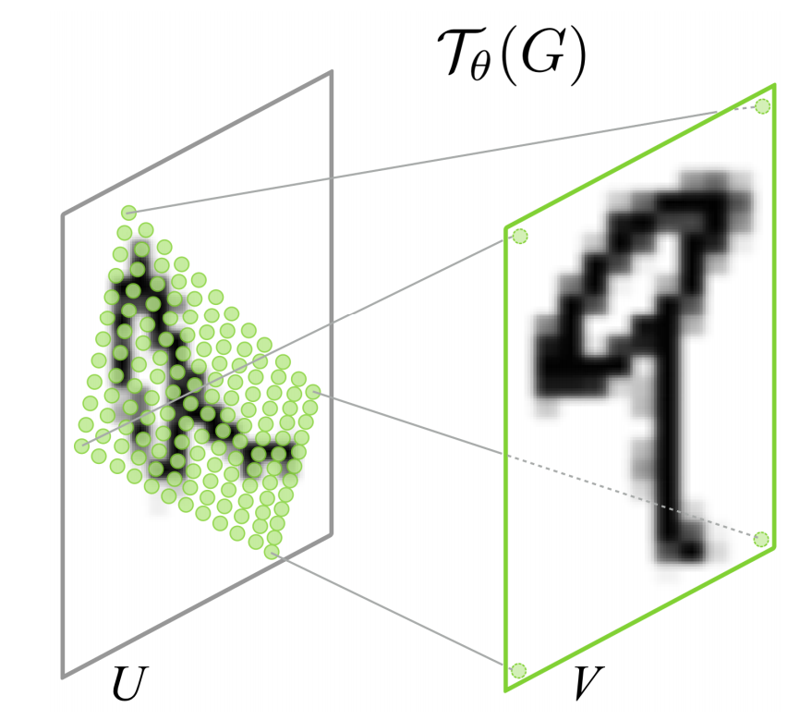
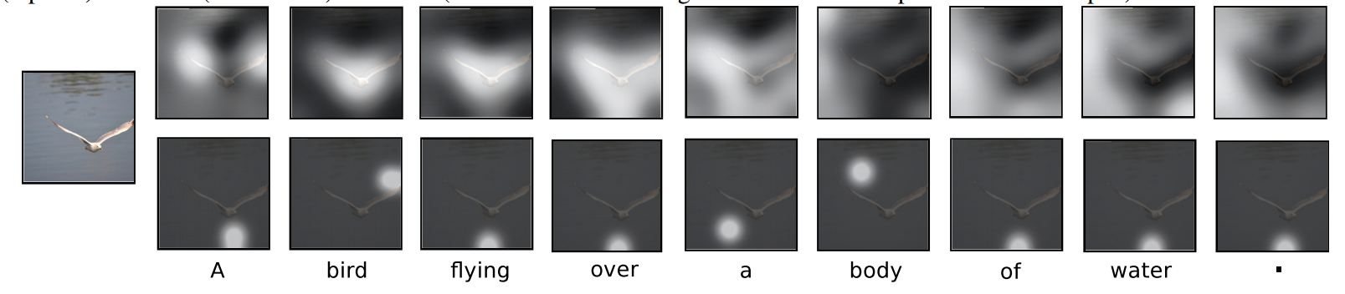
Last class
Spatial Transformer
Segmentation
Soft Attention

Slide 4
Videos

Slide 5

ConvNets for images

Slide 6
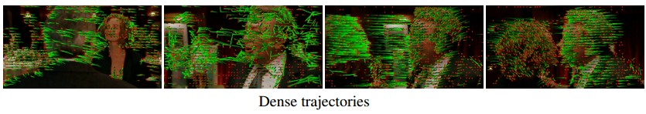
Feature-based approaches to Activity Recognition
Dense trajectories and motion boundary descriptors for action recognition
Wang et al., 2013
Action Recognition with Improved Trajectories
Wang and Schmid, 2013
(code available!)

Slide 7
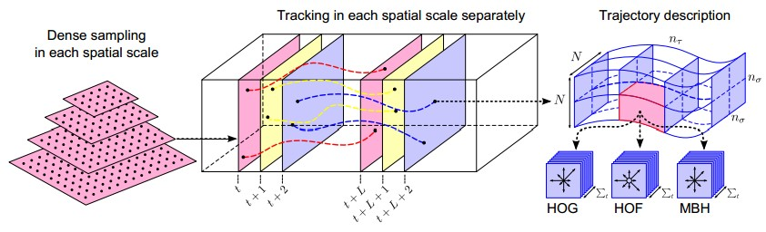
Dense trajectories and motion boundary descriptors for action recognition
Wang et al., 2013
detect feature points
track features with optical flow
extract HOG/HOF/MBH features in the (stabilized) coordinate system of each tracklet

Slide 8
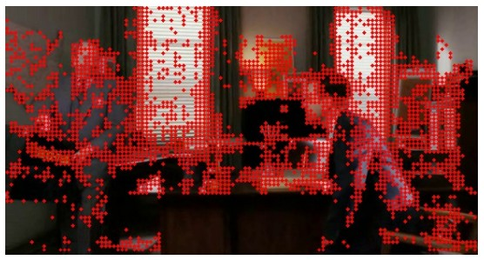
Dense trajectories and motion boundary descriptors for action recognition
Wang et al., 2013
detected feature points
[J. Shi and C. Tomasi, “Good features to track,” CVPR 1994]
[Ivan Laptev 2005]

Slide 9
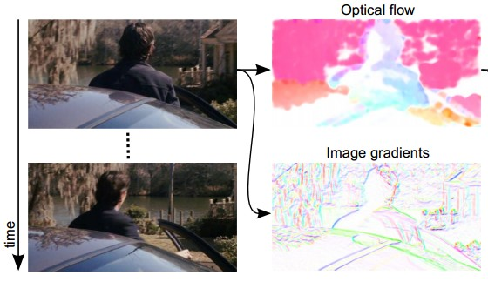
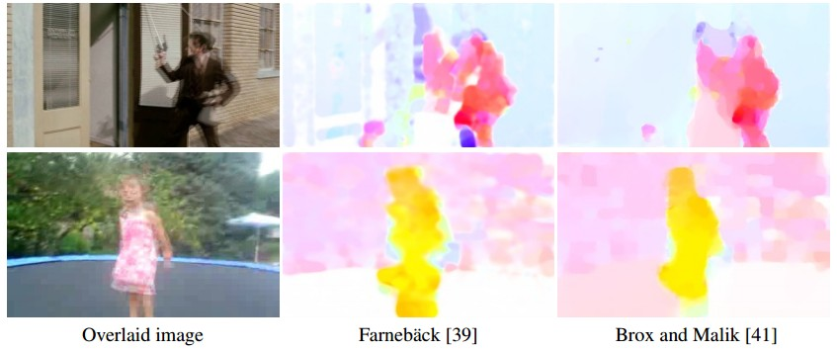
Dense trajectories and motion boundary descriptors for action recognition
Wang et al., 2013
track each keypoint using optical flow.
[G. Farnebäck, “Two-frame motion estimation based on polynomial expansion,” 2003]
[T. Brox and J. Malik, “Large displacement optical flow: Descriptor matching in variational motion estimation,” 2011]

Slide 10
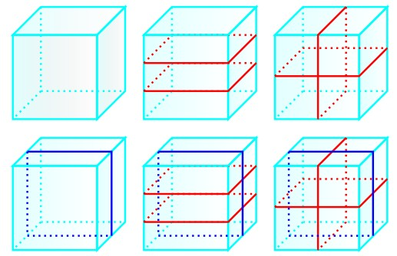
Dense trajectories and motion boundary descriptors for action recognition
Wang et al., 2013
Extract features in the local coordinate system of each tracklet.
Accumulate into histograms, separately according to multiple spatio-temporal layouts.

Slide 11
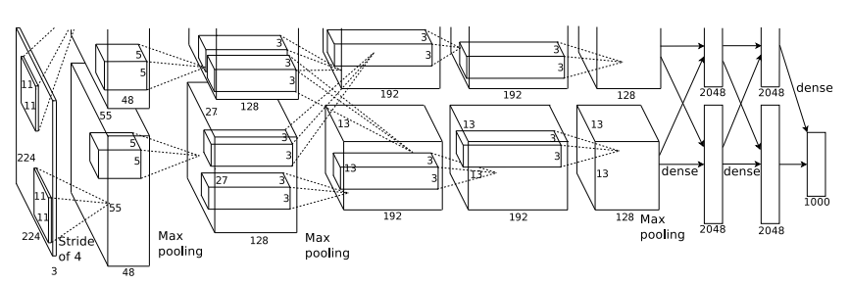
Case Study: AlexNet
[Krizhevsky et al. 2012]
Input: 227x227x3 images
First layer (CONV1): 96 11x11 filters applied at stride 4
=>
Output volume [55x55x96]
Q: What if the input is now a small chunk of video? E.g. [227x227x3x15] ?

Slide 12
Case Study: AlexNet
[Krizhevsky et al. 2012]
Input: 227x227x3 images
First layer (CONV1): 96 11x11 filters applied at stride 4
=>
Output volume [55x55x96]
Q: What if the input is now a small chunk of video? E.g. [227x227x3x15] ?
A: Extend the convolutional filters in time, perform spatio-temporal convolutions!
E.g. can have 11x11xT filters, where T = 2..15.

Slide 13
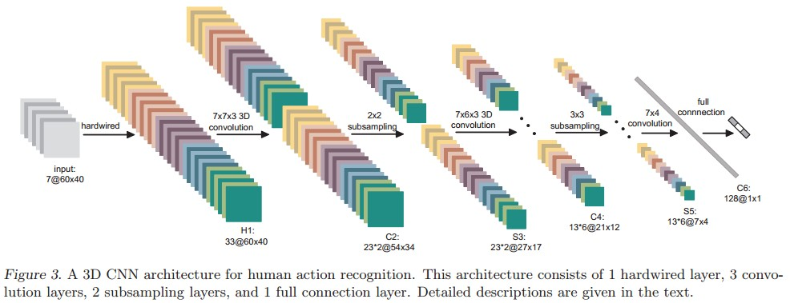
Spatio-Temporal ConvNets
[3D Convolutional Neural Networks for Human Action Recognition, Ji et al., 2010]

Slide 14
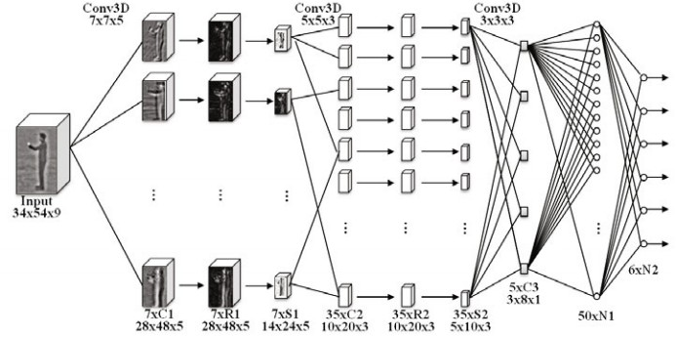
Spatio-Temporal ConvNets
Sequential Deep Learning for Human Action Recognition, Baccouche et al., 2011

Slide 15
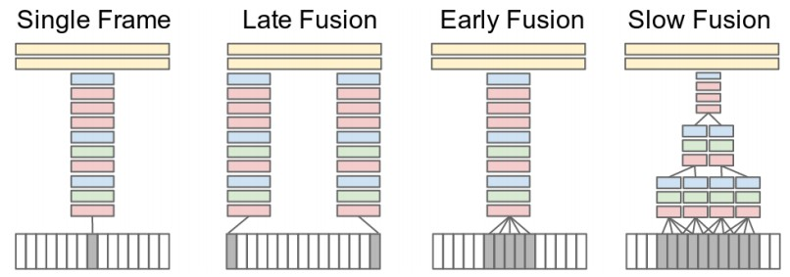
Spatio-Temporal ConvNets
spatio-temporal convolutions;
worked best.
[Large-scale Video Classification with Convolutional Neural Networks, Karpathy et al., 2014]

Slide 16
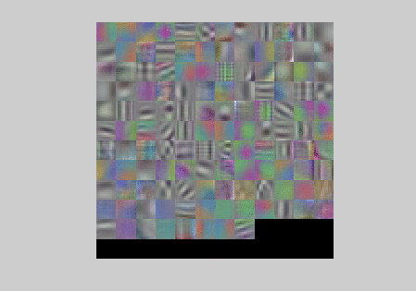
Spatio-Temporal ConvNets
Learned filters on
the first layer
[Large-scale Video Classification with Convolutional Neural Networks, Karpathy et al., 2014]

Slide 17
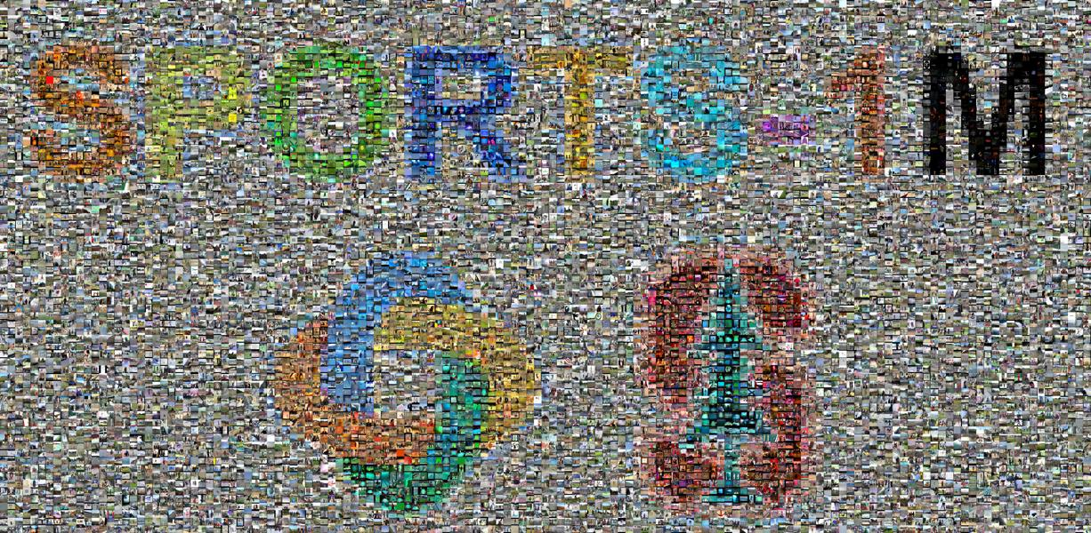
Spatio-Temporal ConvNets
1 million videos
487 sports classes
[Large-scale Video Classification with Convolutional Neural Networks, Karpathy et al., 2014]

Slide 18
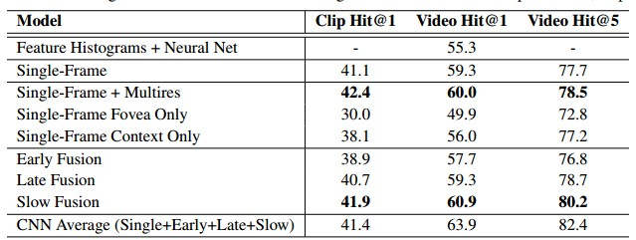
Spatio-Temporal ConvNets
The motion information didn’t add all that much...
[Large-scale Video Classification with Convolutional Neural Networks, Karpathy et al., 2014]

Slide 19
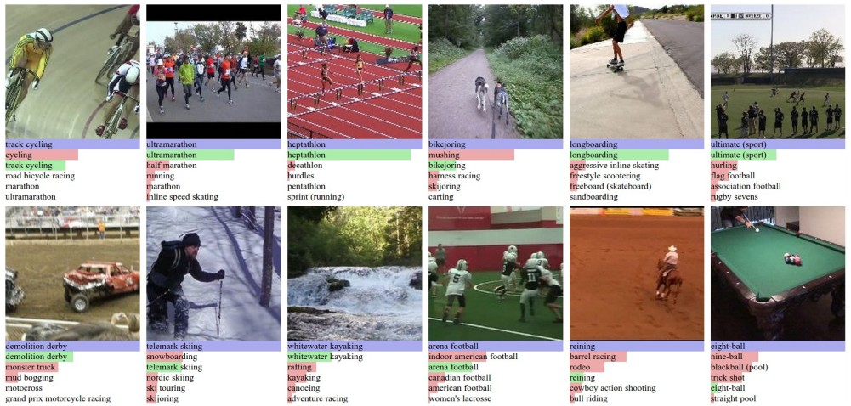
Spatio-Temporal ConvNets

Slide 20
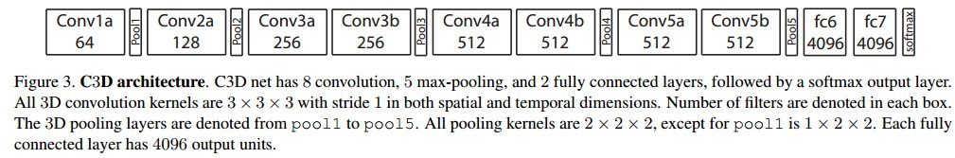
Spatio-Temporal ConvNets
3D VGGNet, basically.
[Learning Spatiotemporal Features with 3D Convolutional Networks, Tran et al. 2015]

Slide 21
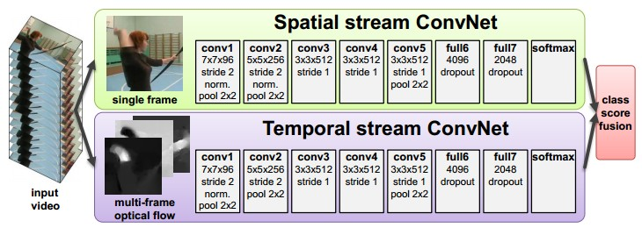
Spatio-Temporal ConvNets
(of VGGNet fame)
[Two-Stream Convolutional Networks for Action Recognition in Videos, Simonyan and Zisserman 2014]
[T. Brox and J. Malik, “Large displacement optical flow: Descriptor matching in variational motion estimation,” 2011]

Slide 22
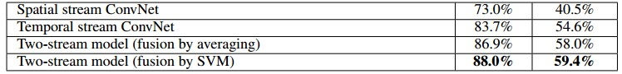
Spatio-Temporal ConvNets
Two-stream version works much better than either alone.
[Two-Stream Convolutional Networks for Action Recognition in Videos, Simonyan and Zisserman 2014]
[T. Brox and J. Malik, “Large displacement optical flow: Descriptor matching in variational motion estimation,” 2011]

Slide 23
Long-time Spatio-Temporal ConvNets
All 3D ConvNets so far used local motion cues to get extra accuracy (e.g. half a second or so)
Q: what if the temporal dependencies of interest are much much longer? E.g. several seconds?
event 1
event 2

Slide 24
Long-time Spatio-Temporal ConvNets
(This paper was way ahead of its time. Cited 65 times.)
Sequential Deep Learning for Human Action Recognition, Baccouche et al., 2011

Slide 25
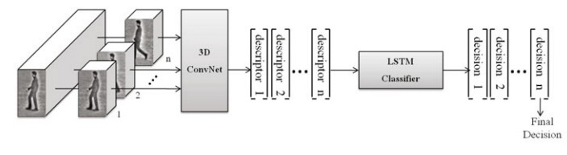
Long-time Spatio-Temporal ConvNets
LSTM way before it was cool
(This paper was way ahead of its time. Cited 65 times.)
Sequential Deep Learning for Human Action Recognition, Baccouche et al., 2011

Slide 26
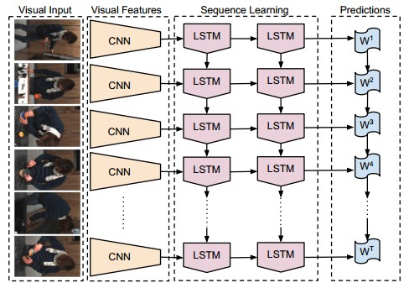
Long-time Spatio-Temporal ConvNets
[Long-term Recurrent Convolutional Networks for Visual Recognition and Description, Donahue et al., 2015]

Slide 27
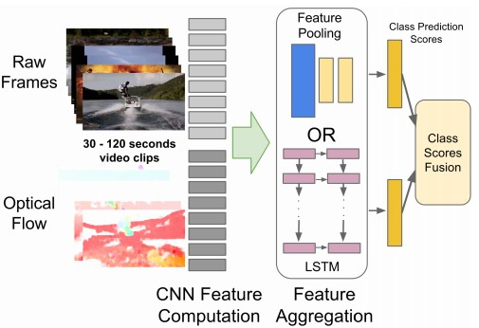
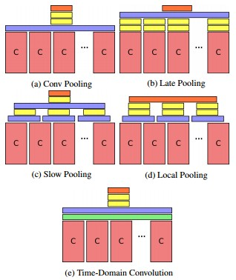
Long-time Spatio-Temporal ConvNets
[Beyond Short Snippets: Deep Networks for Video Classification, Ng et al., 2015]

Slide 28
Summary so far
We looked at two types of architectural patterns:
Model temporal motion locally (3D CONV)
2. Model temporal motion globally (LSTM / RNN)
Fusions of both approaches at the same time.

Slide 29
Summary so far
We looked at two types of architectural patterns:
Model temporal motion locally (3D CONV)
2. Model temporal motion globally (LSTM / RNN)
Fusions of both approaches at the same time.
There is another (cleaner) way!

Slide 30
RNN
Infinite (in theory) temporal extent
(neurons that are function
of all video frames in the past)
3D
CONVNET
Finite temporal
extent
(neurons that are only
a function of finitely many
video frames in the past)
video

Slide 31
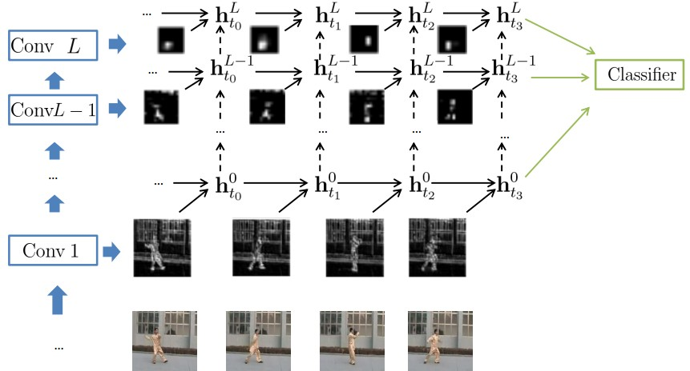
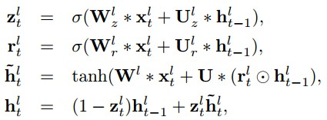
Long-time Spatio-Temporal ConvNets
Beautiful:
All neurons in the ConvNet are recurrent.
Only requires (existing) 2D CONV routines. No need for 3D spatio-temporal CONV.
[Delving Deeper into Convolutional Networks for Learning Video Representations, Ballas et al., 2016]

Slide 32
Long-time Spatio-Temporal ConvNets
Normal ConvNet:
Convolution Layer
[Delving Deeper into Convolutional Networks for Learning Video Representations, Ballas et al., 2016]

Slide 33
Long-time Spatio-Temporal ConvNets
CONV
layer N
RNN-like recurrence (GRU)
layer N+1
at previous
timestep
CONV
layer N+1
[Delving Deeper into Convolutional Networks for Learning Video Representations, Ballas et al., 2016]

Slide 34
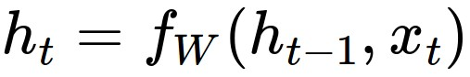
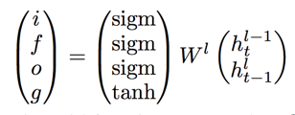
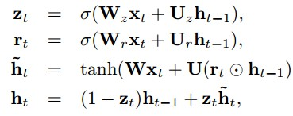
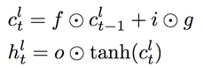
Long-time Spatio-Temporal ConvNets
Recall: RNNs
Vanilla RNN
GRU
LSTM
[Delving Deeper into Convolutional Networks for Learning Video Representations, Ballas et al., 2016]

Slide 35
Long-time Spatio-Temporal ConvNets
Recall: RNNs
Matrix multiply
=>
CONV
GRU
[Delving Deeper into Convolutional Networks for Learning Video Representations, Ballas et al., 2016]

Slide 36
RNN
Infinite (in theory) temporal extent
(neurons that are function
of all video frames in the past)
3D
CONVNET
Finite temporal
extent
(neurons that are only
a function of finitely many
video frames in the past)
video

Slide 37
i.e. we obtain:
RNN
CONVNET
Infinite (in theory) temporal extent
(neurons that are function
of all video frames in the past)
video

Slide 38
Summary
You think you need a Spatio-Temporal Fancy Video ConvNet
STOP. Do you really?
Okay fine: do you want to model:
local motion? (use 3D CONV), or
global motion? (use LSTM).
Try out using Optical Flow in a second stream (can work better sometimes)
Try out GRU-RCN! (imo best model)

Slide 39
Unsupervised Learning

Slide 40
Unsupervised Learning Overview
Definitions
Autoencoders
Vanilla
Variational
Adversarial Networks

Slide 41
Supervised vs Unsupervised
Supervised Learning
Data: (x, y)
x is data, y is label
Goal: Learn a function to map x -> y
Examples: Classification, regression, object detection, semantic segmentation, image captioning, etc

Slide 42
Supervised vs Unsupervised
Supervised Learning
Data: (x, y)
x is data, y is label
Goal: Learn a function to map x -> y
Examples: Classification, regression, object detection, semantic segmentation, image captioning, etc
Unsupervised Learning
Data: x
Just data, no labels!
Goal: Learn some structure of the data
Examples: Clustering, dimensionality reduction, feature learning, generative models, etc.

Slide 43
Unsupervised Learning
Autoencoders
Traditional: feature learning
Variational: generate samples
Generative Adversarial Networks: Generate samples

Slide 44
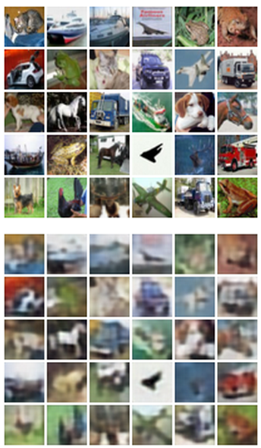
Autoencoders
Features
z
Encoder
Input data
x

Slide 45
Autoencoders
Originally: Linear + nonlinearity (sigmoid)
Later: Deep, fully-connected
Later: ReLU CNN
Features
z
Encoder
Input data
x

Slide 46
Autoencoders
Originally: Linear + nonlinearity (sigmoid)
Later: Deep, fully-connected
Later: ReLU CNN
z usually smaller than x
(dimensionality reduction)
Features
z
Encoder
Input data
x

Slide 47
Autoencoders
Reconstructed input data
xx
Decoder
Features
z
Encoder
Input data
x

Slide 48
Autoencoders
Originally: Linear + nonlinearity (sigmoid)
Later: Deep, fully-connected
Later: ReLU CNN (upconv)
Reconstructed input data
xx
Decoder
Encoder: 4-layer conv
Decoder: 4-layer upconv
Features
z
Encoder
Input data
x

Slide 49
Autoencoders
Originally: Linear + nonlinearity (sigmoid)
Later: Deep, fully-connected
Later: ReLU CNN (upconv)
Reconstructed input data
xx
Encoder / decoder sometimes share weights
Example:
dim(x) = D
dim(z) = H
w_{e}: H x D
w_{d}: D x H = w_{e}^{T}
Decoder
Train for reconstruction with no labels!
Features
z
Encoder
Input data
x

Slide 50
Autoencoders
Loss function (Often L2)
Reconstructed input data
xx
Decoder
Train for reconstruction with no labels!
Features
z
Encoder
Input data
x

Slide 51
Autoencoders
Reconstructed input data
xx
After training,
throw away decoder!
Decoder
Features
z
Encoder
Input data
x

Slide 52
Autoencoders
Loss function (Softmax, etc)
bird
plane
Predicted Label
yy
y
dog
deer
truck
Use encoder to initialize a supervised model
Classifier
Fine-tune encoder jointly with classifier
Train for final task (sometimes with small data)
Features
z
Encoder
Input data
x

Slide 53
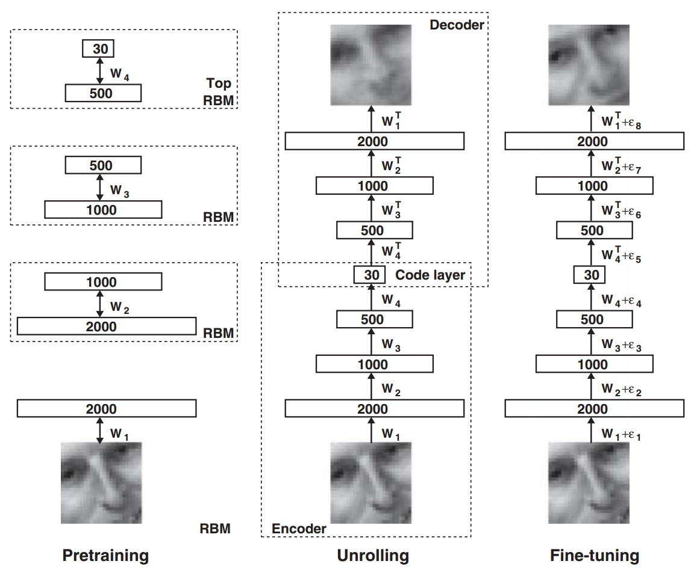
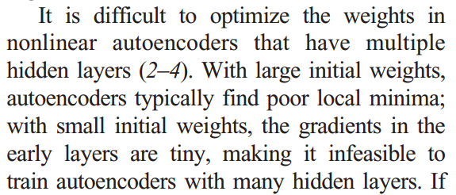
Autoencoders: Greedy Training
In mid 2000s layer-wise pretraining with Restricted Boltzmann Machines (RBM) was common
Training deep nets was hard in 2006!
Hinton and Salakhutdinov, “Reducing the Dimensionality of Data with Neural Networks”, Science 2006

Slide 54
Autoencoders: Greedy Training
In mid 2000s layer-wise pretraining with Restricted Boltzmann Machines (RBM) was common
Training deep nets was hard in 2006!
Not common anymore
With ReLU, proper initialization, batchnorm, Adam, etc easily train from scratch
Hinton and Salakhutdinov, “Reducing the Dimensionality of Data with Neural Networks”, Science 2006

Slide 55
Autoencoders
Autoencoders can reconstruct data, and can learn features to initialize a supervised model
Can we generate images from an autoencoder?
Reconstructed input data
xx
Decoder
Features
z
Encoder
Input data
x

Slide 56
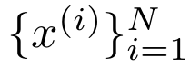
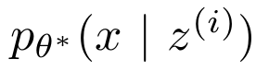
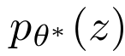
Variational Autoencoder
A Bayesian spin on an autoencoder - lets us generate data!
Assume our data is generated like this:
Sample from true conditional
Sample from true prior
z
x
Kingma and Welling, “Auto-Encoding Variational Bayes”, ICLR 2014

Slide 57
Variational Autoencoder
Intuition: x is an image, z gives class, orientation, attributes, etc
A Bayesian spin on an autoencoder!
Assume our data is generated like this:
Sample from true conditional
Sample from true prior
z
x
Kingma and Welling, “Auto-Encoding Variational Bayes”, ICLR 2014

Slide 58
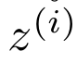
Variational Autoencoder
Intuition: x is an image, z gives class, orientation, attributes, etc
A Bayesian spin on an autoencoder!
Assume our data is generated like this:
Sample from true conditional
Problem: Estimate 𝜃 without access to latent states !
Sample from true prior
z
x
Kingma and Welling, “Auto-Encoding Variational Bayes”, ICLR 2014

Slide 59
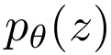
Variational Autoencoder
Prior: Assume
is a unit Gaussian
Kingma and Welling, ICLR 2014

Slide 60
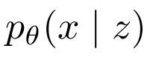
Variational Autoencoder
Prior: Assume
is a unit Gaussian
Conditional: Assume
is a diagonal Gaussian, predict mean and variance with neural net
Kingma and Welling, ICLR 2014

Slide 61
Variational Autoencoder
Mean and (diagonal) covariance of
Prior: Assume
is a unit Gaussian
𝜇^{x}
Σ^{x}
Conditional: Assume
is a diagonal Gaussian, predict mean and variance with neural net
Decoder network with parameters 𝜃
z
Latent state
Kingma and Welling, ICLR 2014

Slide 62
Variational Autoencoder
Mean and (diagonal) covariance of
Prior: Assume
is a unit Gaussian
𝜇^{x}
Σ^{x}
Conditional: Assume
is a diagonal Gaussian, predict mean and variance with neural net
Decoder network with parameters 𝜃
z
Fully-connected or upconvolutional
Latent state
Kingma and Welling, ICLR 2014

Slide 63
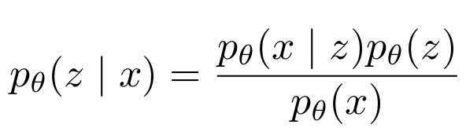
Variational Autoencoder: Encoder
By Bayes Rule the posterior is:
Kingma and Welling,
ICLR 2014

Slide 64
Variational Autoencoder: Encoder
By Bayes Rule the posterior is:
Use decoder network =)
Gaussian =)
Intractible integral =(
Kingma and Welling,
ICLR 2014

Slide 65
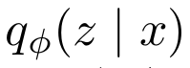
Variational Autoencoder: Encoder
Mean and (diagonal) covariance of
By Bayes Rule the posterior is:
𝜇^{z}
Σ^{z}
Use decoder network =)
Gaussian =)
Intractible integral =(
Encoder network with parameters 𝜙
x
Kingma and Welling,
ICLR 2014
Data point

Slide 66
Variational Autoencoder: Encoder
Mean and (diagonal) covariance of
By Bayes Rule the posterior is:
𝜇^{z}
Σ^{z}
Use decoder network =)
Gaussian =)
Intractible integral =(
Encoder network with parameters 𝜙
Approximate posterior with encoder network
x
Kingma and Welling,
ICLR 2014
Data point

Slide 67
Variational Autoencoder: Encoder
Mean and (diagonal) covariance of
By Bayes Rule the posterior is:
Fully-connected or convolutional
𝜇^{z}
Σ^{z}
Use decoder network =)
Gaussian =)
Intractible integral =(
Encoder network with parameters 𝜙
Approximate posterior with encoder network
x
Kingma and Welling,
ICLR 2014
Data point

Slide 68
Variational Autoencoder
Data point
x
Kingma and Welling, ICLR 2014

Slide 69
Variational Autoencoder
Mean and (diagonal) covariance of
𝜇^{z}
Σ^{z}
Encoder network
Data point
x
Kingma and Welling, ICLR 2014

Slide 70
Variational Autoencoder
z
Sample from
Mean and (diagonal) covariance of
𝜇^{z}
Σ^{z}
Encoder network
Data point
x
Kingma and Welling, ICLR 2014

Slide 71
Variational Autoencoder
𝜇^{x}
Σ^{x}
Mean and (diagonal) covariance of
Decoder network
z
Sample from
Mean and (diagonal) covariance of
𝜇^{z}
Σ^{z}
Encoder network
Data point
x
Kingma and Welling, ICLR 2014

Slide 72
Variational Autoencoder
Reconstructed
xx
Sample from
𝜇^{x}
Σ^{x}
Mean and (diagonal) covariance of
Decoder network
z
Sample from
Mean and (diagonal) covariance of
𝜇^{z}
Σ^{z}
Encoder network
Data point
x
Kingma and Welling, ICLR 2014

Slide 73
Variational Autoencoder
Training like a normal autoencoder: reconstruction loss at the end, regularization toward prior in middle
Reconstructed
xx
Sample from
𝜇^{x}
Σ^{x}
Mean and (diagonal) covariance of
(should be close to data x)
Decoder network
z
Sample from
Mean and (diagonal) covariance of
(should be close
to prior )
𝜇^{z}
Σ^{z}
Encoder network
Data point
x
Kingma and Welling, ICLR 2014

Slide 74
Variational Autoencoder: Generate Data!
After network is trained:
z
Sample from prior

Slide 75
Variational Autoencoder: Generate Data!
After network is trained:
𝜇^{x}
Σ^{x}
Decoder
network
z
Sample from prior

Slide 76
Variational Autoencoder: Generate Data!
After network is trained:
Generated
xx
Sample from
𝜇^{x}
Σ^{x}
Decoder
network
z
Sample from prior

Slide 77
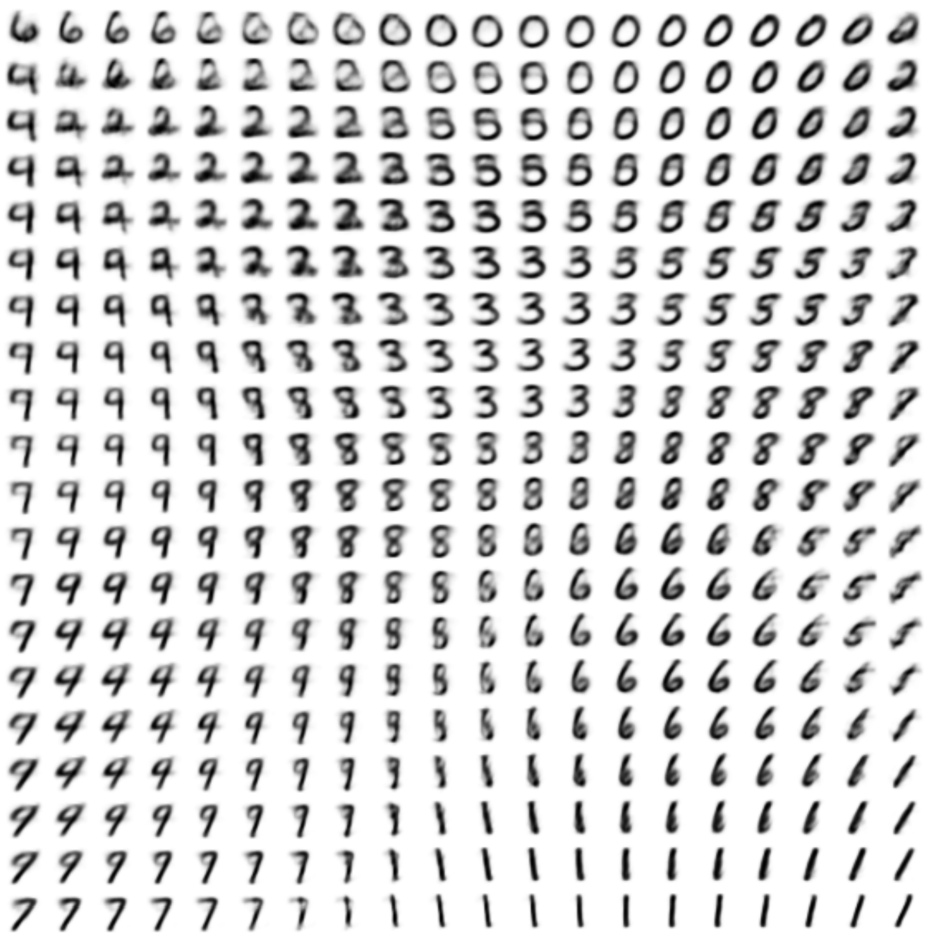
Variational Autoencoder: Generate Data!
After network is trained:
Generated
xx
Sample from
𝜇^{x}
Σ^{x}
Decoder
network
z
Sample from prior

Slide 78
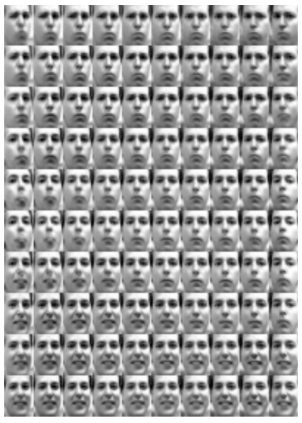
Variational Autoencoder: Generate Data!
After network is trained:
Generated
xx
Sample from
𝜇^{x}
Σ^{x}
Decoder
network
z
Sample from prior

Slide 79
Variational Autoencoder: Generate Data!
Diagonal prior on z => independent latent variables
After network is trained:
Generated
xx
Sample from
𝜇^{x}
Σ^{x}
Decoder
network
z
Sample from prior

Slide 80
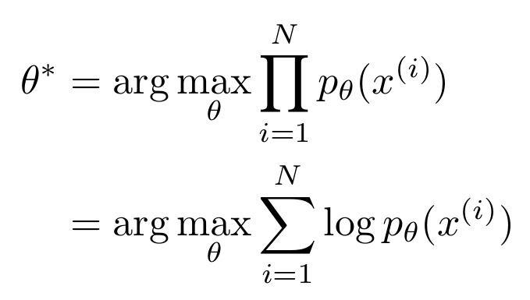
Variational Autoencoder: Math Maximum Likelihood?
Maximize likelihood of dataset
Kingma and Welling, ICLR 2014

Slide 81
Variational Autoencoder: Math Maximum Likelihood?
Maximize likelihood of dataset
Maximize log-likelihood instead because sums are nicer
Kingma and Welling, ICLR 2014

Slide 82
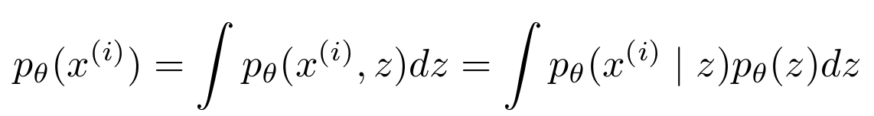
Variational Autoencoder: Math Maximum Likelihood?
Maximize likelihood of dataset
Maximize log-likelihood instead because sums are nicer
Marginalize joint distribution
Kingma and Welling, ICLR 2014

Slide 83
Variational Autoencoder: Math Maximum Likelihood?
Maximize likelihood of dataset
Maximize log-likelihood instead because sums are nicer
Intractible integral =(

Slide 84
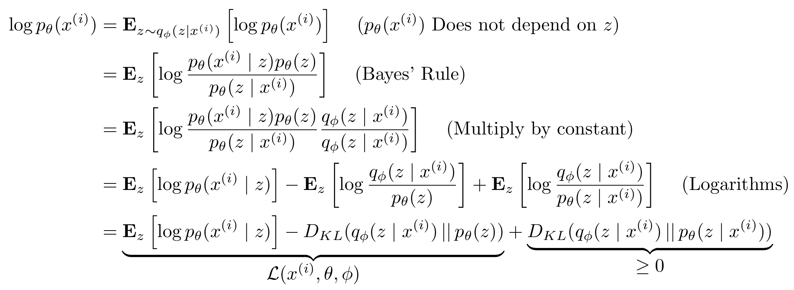
Variational Autoencoder: Math

Slide 85
Variational Autoencoder: Math

Slide 86
Variational Autoencoder: Math

Slide 87
Variational Autoencoder: Math

Slide 88
Variational Autoencoder: Math

Slide 89
Variational Autoencoder: Math

Slide 90
Variational Autoencoder: Math
“Elbow”

Slide 91
Variational Autoencoder: Math
“Elbow”

Slide 92
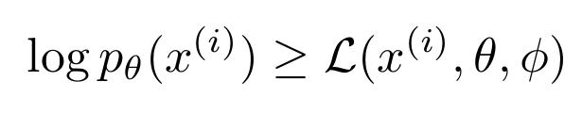
Variational Autoencoder: Math
“Elbow”
Variational lower bound (elbow)

Slide 93
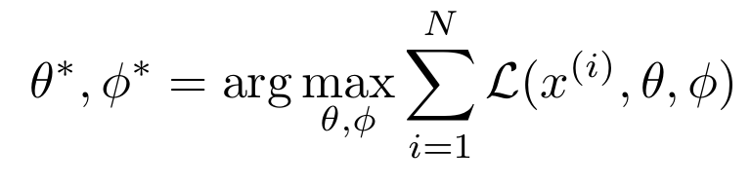
Variational Autoencoder: Math
“Elbow”
Variational lower bound (elbow)
Training: Maximize lower bound

Slide 94
Variational Autoencoder: Math
Reconstruct
the input data
“Elbow”
Variational lower bound (elbow)
Training: Maximize lower bound

Slide 95
Variational Autoencoder: Math
Latent states should follow the prior
Reconstruct
the input data
“Elbow”
Variational lower bound (elbow)
Training: Maximize lower bound

Slide 96
Variational Autoencoder: Math
Latent states should follow the prior
Reconstruct
the input data
Sampling with reparam. trick
(see paper)
“Elbow”
Variational lower bound (elbow)
Training: Maximize lower bound

Slide 97
Variational Autoencoder: Math
Latent states should follow the prior
Reconstruct
the input data
Everything is Gaussian, closed form solution!
Sampling with reparam. trick
(see paper)
“Elbow”
Variational lower bound (elbow)
Training: Maximize lower bound

Slide 98
Autoencoder Overview
Traditional Autoencoders
Try to reconstruct input
Used to learn features, initialize supervised model
Not used much anymore
Variational Autoencoders
Bayesian meets deep learning
Sample from model to generate images

Slide 99
Generative Adversarial Nets
Goodfellow et al, “Generative Adversarial Nets”, NIPS 2014
Can we generate images with less math?
Random noise
z

Slide 100
Generative Adversarial Nets
Goodfellow et al, “Generative Adversarial Nets”, NIPS 2014
Can we generate images with less math?
Fake image
x
Generator
Random noise
z

Slide 101
Generative Adversarial Nets
Goodfellow et al, “Generative Adversarial Nets”, NIPS 2014
Can we generate images with less math?
Real or fake?
y
Discriminator
Fake image
x
Generator
Random noise
z

Slide 102
Generative Adversarial Nets
Goodfellow et al, “Generative Adversarial Nets”, NIPS 2014
Can we generate images with less math?
Real or fake?
y
Discriminator
Fake image
x
x
Real image
Generator
Fake examples: from generator
Real examples: from dataset
Random noise
z

Slide 103
Generative Adversarial Nets
Goodfellow et al, “Generative Adversarial Nets”, NIPS 2014
Can we generate images with less math?
Real or fake?
y
Train generator and discriminator jointly
After training, easy to generate images
Discriminator
Fake image
x
x
Real image
Generator
Fake examples: from generator
Real examples: from dataset
Random noise
z

Slide 104
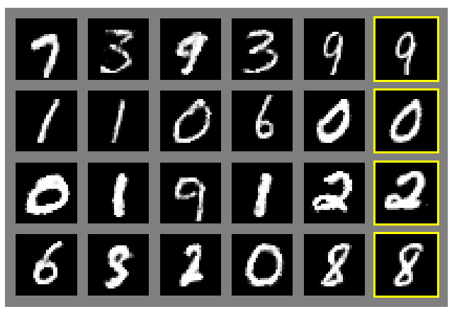

Generative Adversarial Nets
Generated samples
Nearest neighbor from training set
Goodfellow et al, “Generative Adversarial Nets”, NIPS 2014

Slide 105


Generative Adversarial Nets
Generated samples (CIFAR-10)
Nearest neighbor from training set
Goodfellow et al, “Generative Adversarial Nets”, NIPS 2014

Slide 106

Generative Adversarial Nets: Multiscale
Generate low-res
Denton et al, “Deep generative image models using a Laplacian pyramid of adversarial networks”, NIPS 2015

Slide 107
Generative Adversarial Nets: Multiscale
Upsample
Generate low-res
Denton et al, “Deep generative image models using a Laplacian pyramid of adversarial networks”, NIPS 2015

Slide 108
Generative Adversarial Nets: Multiscale
Upsample
Generate delta, add
Generate low-res
Denton et al, “Deep generative image models using a Laplacian pyramid of adversarial networks”, NIPS 2015

Slide 109
Generative Adversarial Nets: Multiscale
Upsample
Upsample
Generate delta, add
Generate low-res
Denton et al, “Deep generative image models using a Laplacian pyramid of adversarial networks”, NIPS 2015

Slide 110
Generative Adversarial Nets: Multiscale
Upsample
Upsample
Generate delta, add
Generate delta, add
Generate low-res
Denton et al, “Deep generative image models using a Laplacian pyramid of adversarial networks”, NIPS 2015

Slide 111
Generative Adversarial Nets: Multiscale
Upsample
Upsample
Upsample
Generate delta, add
Generate delta, add
Generate low-res
Denton et al, “Deep generative image models using a Laplacian pyramid of adversarial networks”, NIPS 2015

Slide 112
Generative Adversarial Nets: Multiscale
Done!
Upsample
Upsample
Upsample
Generate delta, add
Generate delta, add
Generate delta, add
Generate low-res
Denton et al, “Deep generative image models using a Laplacian pyramid of adversarial networks”, NIPS 2015

Slide 113

Generative Adversarial Nets: Multiscale
Discriminators work at every scale!
Denton et al, NIPS 2015

Slide 114

Generative Adversarial Nets: Multiscale
Train separate model per-class on CIFAR-10
Denton et al, NIPS 2015

Slide 115

Generative Adversarial Nets: Simplifying
Generator is an upsampling network with fractionally-strided convolutions
Discriminator is a convolutional network
Radford et al, “Unsupervised Representation Learning with Deep Convolutional Generative Adversarial Networks”, ICLR 2016

Slide 116

Generative Adversarial Nets: Simplifying
Generator
Radford et al, “Unsupervised Representation Learning with Deep Convolutional Generative Adversarial Networks”, ICLR 2016

Slide 117

Generative Adversarial Nets: Simplifying
Samples from the model look amazing!
Radford et al, ICLR 2016

Slide 118

Generative Adversarial Nets: Simplifying
Interpolating between random points in latent space
Radford et al, ICLR 2016

Slide 119

Generative Adversarial Nets: Vector Math
Smiling woman
Neutral woman
Neutral man
Radford et al, ICLR 2016
Samples from the model

Slide 120
Generative Adversarial Nets: Vector Math
Smiling woman
Neutral woman
Neutral man
Radford et al, ICLR 2016
Samples from the model
Average Z
vectors, do arithmetic

Slide 121
Generative Adversarial Nets: Vector Math
Smiling woman
Neutral woman
Neutral man
Radford et al, ICLR 2016
Smiling Man
Samples from the model
Average Z
vectors, do arithmetic

Slide 122

Generative Adversarial Nets: Vector Math
Glasses man
No glasses man
No glasses woman
Radford et al, ICLR 2016

Slide 123
Generative Adversarial Nets: Vector Math
Glasses man
No glasses man
No glasses woman
Woman with glasses
Radford et al, ICLR 2016

Slide 124
Putting everything together
Dosovitskiy and Brox, “Generating Images with Perceptual Similarity Metrics based on Deep Networks”, arXiv 2016
Pixel loss
xx
Variational
Autoencoder
𝜇^{x}
Σ^{x}
z
𝜇^{z}
Σ^{z}
x

Slide 125
Putting everything together
Dosovitskiy and Brox, “Generating Images with Perceptual Similarity Metrics based on Deep Networks”, arXiv 2016
Real or Generated
Discriminator
network
Pixel loss
y
xx
Variational
Autoencoder
𝜇^{x}
Σ^{x}
z
𝜇^{z}
Σ^{z}
x

Slide 126

Putting everything together
Dosovitskiy and Brox, “Generating Images with Perceptual Similarity Metrics based on Deep Networks”, arXiv 2016
Real or Generated
Pretrained AlexNet
Discriminator
network
Pixel loss
y
xx
Variational
Autoencoder
𝜇^{x}
Σ^{x}
z
𝜇^{z}
Σ^{z}
x

Slide 127
Putting everything together
Dosovitskiy and Brox, “Generating Images with Perceptual Similarity Metrics based on Deep Networks”, arXiv 2016
Real or Generated
Pretrained AlexNet
Discriminator
network
Pixel loss
y
xx
Variational
Autoencoder
𝜇^{x}
Σ^{x}
Features of reconstructed image
Features of real image
xf
xxf
z
𝜇^{z}
Σ^{z}
x

Slide 128
Putting everything together
Dosovitskiy and Brox, “Generating Images with Perceptual Similarity Metrics based on Deep Networks”, arXiv 2016
Real or Generated
Pretrained AlexNet
Discriminator
network
Pixel loss
y
xx
Variational
Autoencoder
𝜇^{x}
Σ^{x}
Features of reconstructed image
Features of real image
xf
xxf
z
𝜇^{z}
Σ^{z}
L2 loss
x

Slide 129

Putting everything together
Dosovitskiy and Brox, “Generating Images with Perceptual Similarity Metrics based on Deep Networks”, arXiv 2016
Samples from the model, trained on ImageNet

Slide 130
Recap
Videos
Unsupervised learning
Autoencoders: Traditional / variational
Generative Adversarial Networks
Next time: Guest lecture from Jeff Dean

